Slide 1
Understanding Block Grants And Other Threats to Medicaid in 2017
Janice Meinert
Kyle Fisher
kfisher@phlp.org
February 2017
Notes:
Lay of the land- focus on expansion coverage and MAWD, incorporate COMPASS tips

Slide 2
Topics
ACA Repeal & Medicaid Reform
Understanding Medicaid
Traditional Medicaid
Expanded Medicaid
Medicaid Funding
Block Grant Funding Structure
Per Capita Allotments
Proposed Legislation?
Notes:
Poll audience – how many do assist patients medicaid elig & enrollment?

Slide 3
Post-election Outlook
ACA “Repeal” “Replace” “Repair”
By all accounts, lack of consensus among Congressional leadership and new Administration
Medicaid “reform” likely passed simultaneously
20 Republican Senators from Medicaid expansion states
Day 1: ACA-related Executive Order
Shift in rhetoric from “immediate repeal” to “end of the year” and “later in the spring”
Notes:
2/5 int. w/ Fox – President stated could take into the next year
- EO does not change the law, of course, or undo any regulation (rule-making a long process)
- significant areas where discretion – “hardship” exemption from individual mandate, e.g.;

Slide 4
Block Grant Proposals
The Advisory Board, 12/22/16
Notes:
- prominent feature of many Republican proposals; including Speaker Ryan’s “A Better Way” and Rep. Price’s “Empowering Patient’s First”
https://www.advisory.com/daily-briefing/2016/12/22/gop-plan-health-care-trump-administration

Slide 5
What’s a block grant?
Above all, a block grant is a funding mechanism
Designed to reduce federal Medicaid spending
Explicit goal is to achieve federal budget savings
Gives states fixed annual payments
With states liable for any costs in excess of the cap
Alternative to the current federal matching system
Would eliminate open-ended funding commitment
And remove federal requirements in exchange
Notes:
And to end the entitlement nature of Medicaid

Slide 6
House Republican Policy Brief
House GOP leadership policy outline released mid-Feb:
Repeals Medicaid expansion
Freezes enrollment; offers “stability” period, after which enhanced federal match reduced to traditional match
Reforms Medicaid with “Per Capita Allotment”
“Putting Medicaid on a Budget”
Federal allotment based on a preset formula, not actual costs
Block Grants become a State Option
Notes:
Included no estimates of cost or coverage impact; among other things – provide tax credits based on age, rather than income

Slide 7
Understanding Medicaid
Currently, Medicaid has a shared funding structure
Federal gov’t matches state expenditures, with no upper limit
Distinguish between*:
Traditional Medicaid
Federal match rate of 50-75%, which varies by state
Pennsylvania’s current federal match is 51.78% (2017)
Expanded Medicaid
Enhanced federal match
100% in 2015-16; 95% in 2017; 94% in 2018, 93% in 2019; 90% in 2020 and beyond
*Adopted with thanks to CLS
Notes:
enhanced matches – family planning at 90%, e.g.; separate FFP rate for administration, IT
5% drop in enhanced FMAP equals over $200 M in FY17-18

Slide 8
Traditional Medicaid
Traditional Medicaid covers certain populations with low incomes:
Seniors
Individuals with long-term disabilities
Children
Pregnant women, and
Very low-income parents
Every state offers traditional Medicaid to its residents, though benefits and eligibility rules vary from state to state.

Slide 9
Expanded Medicaid
Affordable Care Act (ACA)
Required states to expand Medicaid to adults
With income under 138% FPL, and
Not covered by Medicare or traditional Medicaid
Made optional by the U.S. Supreme Court in 2012
31 states, plus Washington, D.C., have expanded so far
Enhanced match
100% in 2014-16; 95% in 2017
94% in 2018, 93% in 2019; 90% in 2020 and beyond
Notes:
1/20 -- $ Gov. -- $200 million / GOP plan – repeal – $2 Billion

Slide 10
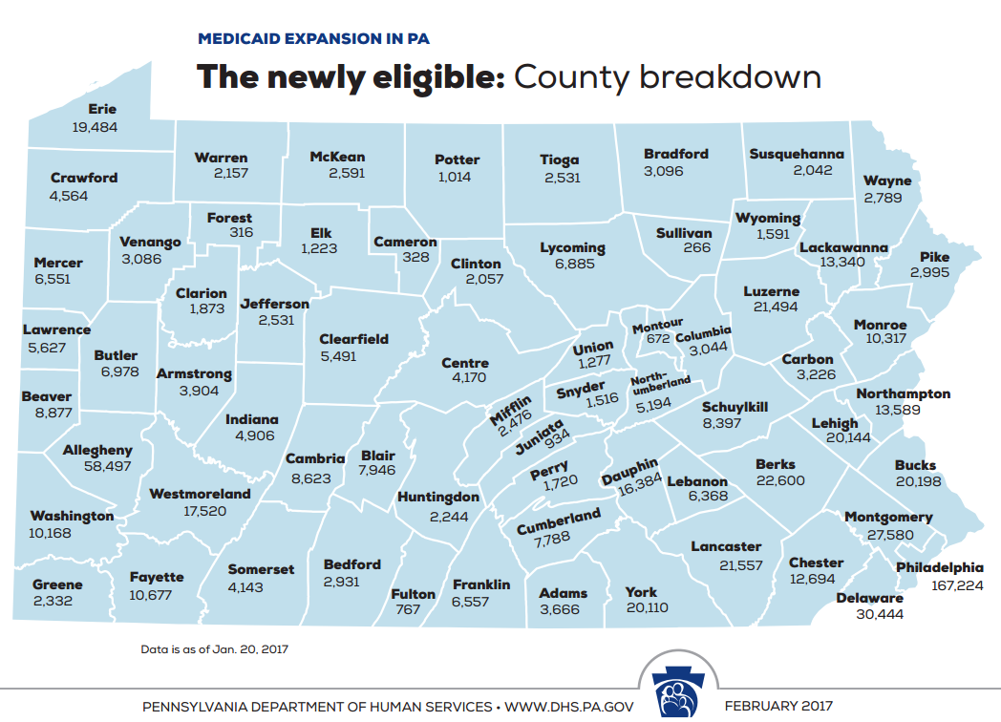

Slide 11
Medicaid Funding
What’s at stake?
Covered lives:
2.8 million Medicaid enrollees in PA
700,000 of whom are in expanded Medicaid
Funding:
$14.4 billion in federal Medicaid funding (CY 2015)
Compared to PA’s state share of $10.6B
$2.8 billion (CY 2015)
Federal funding for expanded Medicaid - DHS report (1/2017)

Slide 12
Medicaid Funding
Notes:
* PA obligation to meet its share ; reimbursement

Slide 13
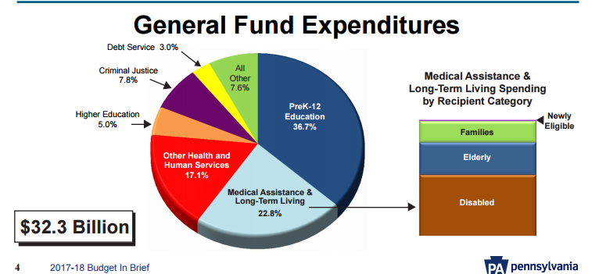
Source: Gov. Wolf’s Proposed FY 2017-18 Budget
Notes:
Scale – medicaid a huge portion of overall state budget, easily the largest source of federal funding

Slide 14
Requirements
States are bound by some federal Medicaid rules:
Eligibility:
Medicaid is an entitlement – anyone who qualifies must be enrolled
No waiting lists
Eligibility decisions must be made promptly
Benefits & Access:
Certain benefits must be covered
Enrollees must have access to community health centers and their choice of family planning providers
Provider reimbursements must be sufficient to create “equal access”
Payment to MCOs must be “actuarially sound,” sufficient to cover costs

Slide 15
Flexibility
States have flexibility in designing their Medicaid programs:
They can cover optional benefits (e.g., optometry, dental care).
They can use managed care networks.
They can implement limited cost-sharing (e.g., nominal copays).
States can seek “waivers” of federal Medicaid rules to test out new ways to provide care:
Waivers must “further the objectives” of the Medicaid program
No mandatory work requirements, premiums with lockouts, etc.

Slide 16
Flexibility
Pennsylvania:
Provides comprehensive benefits package
Requires most consumers to receive coverage through an MCO
Charges nominal copays
Adjusts eligibility rules for children with autism and other serious disabilities
Pennsylvania has eleven federal Medicaid waivers:
Most allow Pennsylvania to provide home and community based services to seniors and individuals with serious disabilities

Slide 17
Block Grants
Designed to achieve federal budget savings
By shifting costs to states, providers, and recipients
“The House Republican budget plan for fiscal year 2017, for example, would have cut federal Medicaid funding by $1 trillion — or nearly 25 percent — over ten years, relative to current law, on top of the cuts the plan would secure from repealing the ACA’s Medicaid expansion.”
Edwin Park, Center on Budget & Policy Priorities (Nov. 2016)

Slide 18
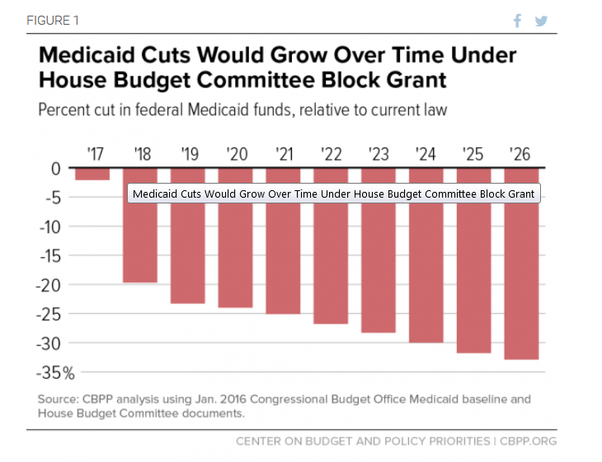
Medicaid Block Grants
Under most proposals, states would face small losses in the first year or two.
But block grant increases would be capped at low, fixed rates, regardless of medical inflation or enrollment growth.
Over time, states would face huge budget shortfalls.

Slide 19
Block Grant Experience
CBPP analysis of 13 enacted block grants:
“Since 2000, overall funding for the 13 major housing, health, and social services block grant programs in the federal budget has fallen by 27 percent after adjusting for inflation.”
Notes:
http://www.cbpp.org/research/federal-budget/block-granting-low-income-programs-leads-to-large-funding-declines-over-time
- includes TANF; job training; child care; county MH services block grant; spike in 2009 w/ recovery & reinvestment act; temporary infusions
- irony, additional flexibility, reduced federal standards, leads to vulnerability – attacked as “no strings attached slush fund”

Slide 20
Medicaid Funding
Two-fold danger:
(1) reduction of federal funds over time
(2) elimination of state share requirement
Under the current structure, states submit quarterly to the federal government for reimbursement
PA has to pay its 48.2% to receive its 51.8% federal match, e.g.
Block grant structure could allow states to use what is now state share payments to plug budget holes
If state share is still required, question whether provider taxes (which PA relies on heavily) would continue to count
Notes:
*critical to overall Medicaid funding / always budget holes – pension, education, one budget crises or another

Slide 21
Flexibility
Under block grants:
Medicaid would no longer be an entitlement.
Many federal Medicaid requirements would likely be eliminated.
Proponents argue that, freed from federal requirements, states could save money by innovating.
In truth, huge cuts in federal funding mean that states would have no choice but to cut benefits, cut provider payments, and cut back enrollment.

Slide 22
Source: Gov. Wolf’s Proposed FY 2017-18 Budget
Notes:
Leaves policymakers to choose who’s the most worthy? With added factor of bulk of spending going towards elderly and disabled. NH and HCBS, for example. Children who need shift nursing.

Slide 23
Block Grants
Block grants allow states to divert money away from people who need it most, to fund pet projects or fill budget holes.
Block grants create “winners” and “losers” among states.
Huge consequences to how the baseline is set
Potentially locks-in policy decisions like not expanding Medicaid, and historic and geographic variations in spending
Block grants fail to respond to economic downturns.

Slide 24
Per Capita Caps
Per capita caps are designed, like block grants, to achieve federal budget savings
Funding per enrollee would be capped
Account for enrollment changes, but not changes in technology or health care costs
Unlikely to keep up with healthcare inflation
Limit the ability of states to respond to epidemics like HIV/AIDS or breakthroughs like new Hepatitis C medications
Lead to same pressures on states to cut benefits, cut provider payments, and cut enrollment

Slide 25
House Republican Policy Brief
“Modernizing and Strengthening Medicaid to Protect the Most Vulnerable”
Safety net program for nation’s “most vulnerable” patients – children, pregnant women, elderly, blind, disabled
Put in jeopardy by “unsustainable” and “unfair” enhanced federal funding for “able-bodied adults”
Suggests that some Medicaid beneficiary groups more deserving than others
Repeals Obamacare’s “unfair” and “unsustainable” Medicaid expansion
Notes:
Clearly meant to pit groups against one another
Concern for most vulnerable betrayed by funding cuts inherent in per capita caps

Slide 26
House Republican Policy Brief
“Putting Medicaid On a Budget By Reforming Medicaid Financing With a Per Capita Allotment
… The amount of the federal allotment will be the product of the state’s per capita allotment for major beneficiary categories —aged, blind and disabled, children, and adults—multiplied by the number of enrollees in each group.
The per capita allotments for each beneficiary group will be determined by each state’s average Medicaid spending in a base year, grown by an inflationary index.
Some federal payments, including disproportionate share hospital (DSH) payments, administrative costs, and others, are excluded from the total allotment.”
Notes:
- immediate cuts! Administrative costs and unspecified “other” federal payments – not included in allotment
- plus more cuts down the line – whatever “inflationary index” they choose, almost certainly not keep pace with healthcare inflation – that’s the point, why his is budget saving mechanism

Slide 27
Budget Reconciliation
Block grants or per capita caps can be enacted through federal budget “reconciliation”
Process through which legislation that affects the federal budget can pass with a simple majorities in both houses of Congress
Avoids filibuster in the Senate – only 51 votes are needed to pass a reconciliation bill
Precedent - TANF block grants were established via budget reconciliation in 1996.
Notes:
Now that ACA repeal has been delayed to February or March 2017, it’s not clear when Congress might attempt to address Medicaid funding. May attempt “entitlement reform” at the same time as ACA repeal

Slide 28
Other Threats to Medicaid
The federal Centers for Medicare & Medicaid Services (CMS) under the Obama Administration would not grant state Medicaid waivers that were unrelated to the purpose of the Medicaid program.
The Trump Administration has nominated as head of CMS a consultant who has championed waivers that promote “personal responsibility”
Medicaid work requirements, HSAs, and premiums with lockouts
If CMS starts granting waivers it has previously rejected, states will have new latitude to limit access to their Medicaid programs.

Slide 29
Opportunity to Take Action
Stay informed:
Join the InsurePA campaign (www.insurepa.org)
Visit Community Legal Services’ website (www.clsphila.org)
Visit PHLP’s website (www.phlp.org)
Speak out (in your capacity as individual citizens)
Call your Congressional Representative & U.S. Senators

